Slide 1

Prediction of diabetes using machine learning

Slide 2

What is Diabetes ?

Slide 3

Early Signs Of Diabetes
Extreme Fatigue
Blurred Vision
Unusual Thirst
Weight Loss
Dark Patches
Frequent or Recurring Infections
Tingling or Numbness
Increased Hunger
Itchy

Slide 4


Slide 5
TYPE 1 DIABETES
Typically associated with : Children to young adults
Risk Factors : Generic or Environmental Factors
TYPE 2 DIABETES
Typically associated with : Adult onset
Risk Factors : Obesity, older age, family of personal history of disease
Accounts for : 90 – 95 % of all cases
Treated with : Insulin
Accounts for : 5% of all cases
Preventable : No
GESTATIONAL DIABETES
Typically associated with : Pregnant woman
Risk Factors : Obesity or family history of diabetes
Treated with : Diet, exercise and sometimes with oral drugs or insulin
Preventable : Yes
Treated with : Diet and exercise or insulin
Preventable : Recent studies suggest there may be ways to prevent some cases
Accounts for : upto 9 of pregnant woman
TYPES OF DIABETES

Slide 6



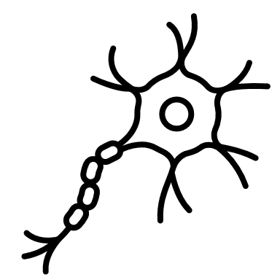



RISK AND FURTHER COMPLICATIONS
Diabetes can lead to a number of further complications, including :
Stroke
Eye Disease
Nerve Damage
Heart Disease
Kidney Disease
Diabetic Foot

Slide 7


Slide 8
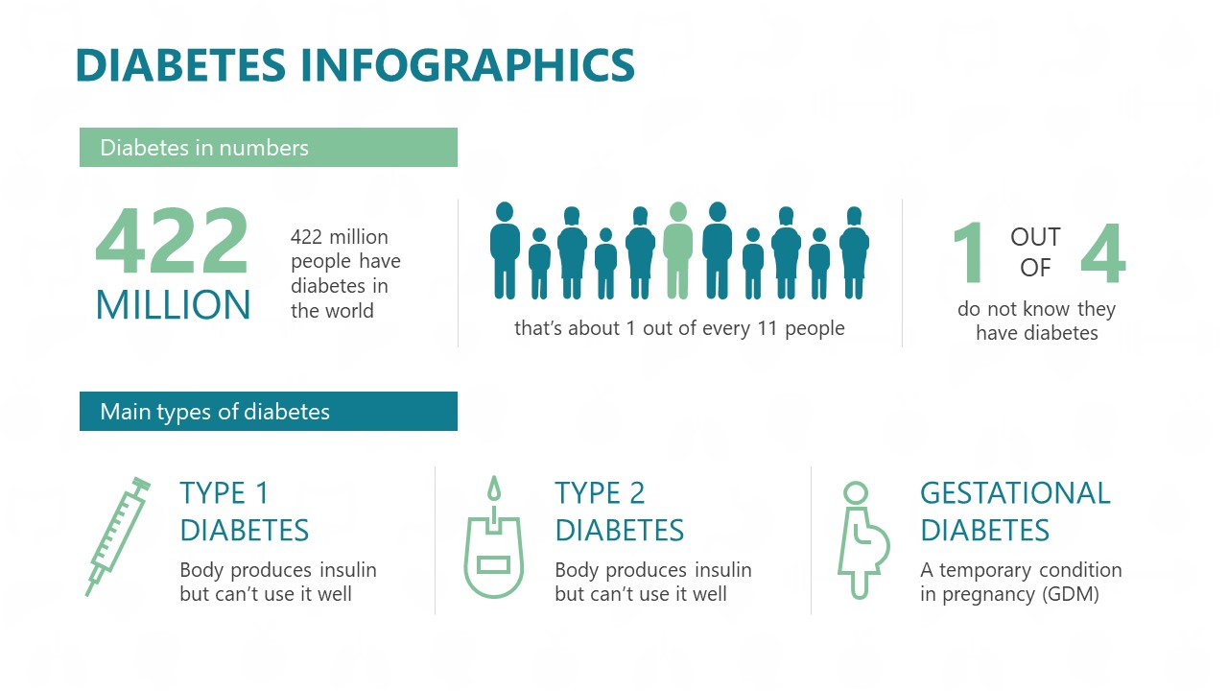

Slide 9
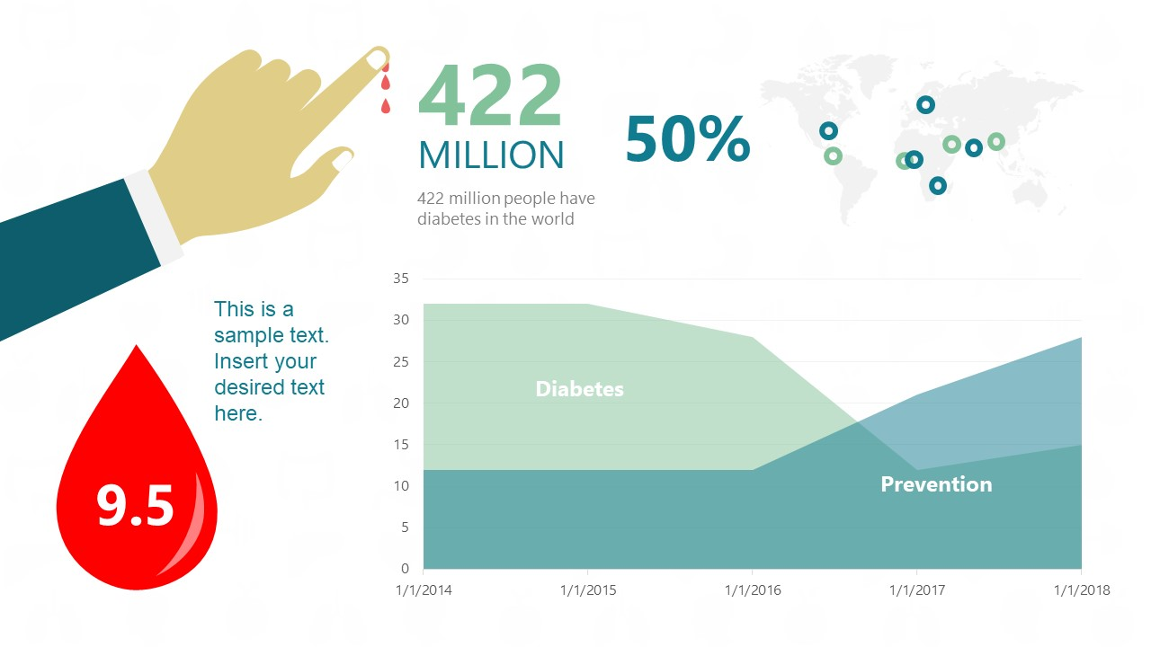


Slide 10

How we can Help ?

Slide 11
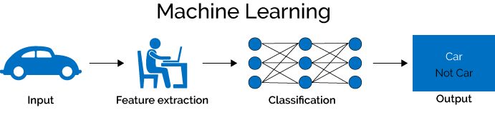
The Machine Learning Process
Machine Learning is an aspect of Artificial Intelligence which can enable computers to learn with experience, much like humans, without us being needed to program them every single time.
ML is data driven. This simply means that we feed the data to our machine and then it has the potential to learn and draw patterns, and ultimately help in predicting the outcome of an unknown or unmarked value.

Slide 12
Random Forest Algorithm
A Random Forest Algorithm is a supervised machine learning algorithm which is extremely popular and is used for Classification and Regression problems in Machine Learning. We know that a forest comprises numerous trees, and the more trees more it will be robust. Similarly, the greater the number of trees in a Random Forest Algorithm, the higher its accuracy and problem-solving ability. Random Forest is a classifier that contains several decision trees on various subsets of the given dataset and takes the average to improve the predictive accuracy of that dataset. It is based on the concept of ensemble learning which is a process of combining multiple classifiers to solve a complex problem and improve the performance of the model.

Slide 13
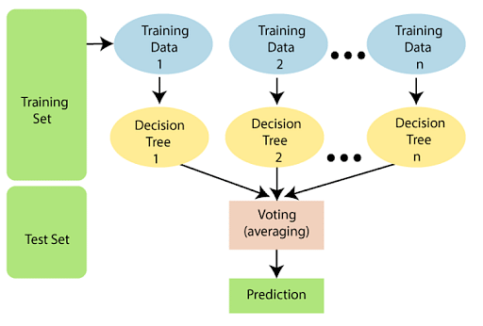
Working of Random Forest Algorithm

Slide 14

Some Points about Random forest algorithm
>It takes less training time as compared to other algorithms.
>It predicts output with high accuracy, even for the large dataset it runs efficiently.
>It can also maintain accuracy when a large proportion of data is missing.

Slide 15

Thank You

